Slide 1
Network Structure
Hung-yi Lee
李宏毅

Slide 2
Three Steps for Deep Learning
Step 1: Neural Network
Step 2: Cost Function
Step 3: Optimization
Step 1. A neural network is a function composed of simple functions (neurons)
Usually we design the network structure, and let machine find parameters from data
Step 2. Cost function evaluates how good a set of parameters is
We design the cost function based on the task
Step 3. Find the best function set (e.g. gradient descent)
Notes:
http://www.twword.com/wiki/%E8%85%A6%E6%88%B6%E7%A9%B4
http://ukenglish.pixnet.net/blog/post/105691160-%E3%80%90%E5%8F%B0%E5%8D%97%E5%B8%82%E5%AD%B8%E8%8B%B1%E8%AA%9E%EF%BC%8C%E5%84%AA%E9%85%B7%E8%8B%B1%E8%AA%9E%E6%96%87%E7%90%86%E5%85%AC%E5%91%8A%E3%80%91%E6%9C%AC%E4%B8%AD%E5%BF%83
http://onepiece1234567890.blogspot.tw/2013/12/blog-post_8.html

Slide 3
Outline
Basic structure (3/03)
Fully Connected Layer
Recurrent Structure
Convolutional/Pooling Layer
Special Structure (3/17)
Spatial Transformation Layer
Highway Network / Grid LSTM
Recursive Structure
Batch Normalization
Sequence-to-sequence / Attention (3/24)

Slide 4
Prerequisite
Brief Introduction of Deep Learning
https://youtu.be/Dr-WRlEFefw?list=PLJV_el3uVTsPy9oCRY30oBPNLCo89yu49
Convolutional Neural Network
https://youtu.be/FrKWiRv254g?list=PLJV_el3uVTsPy9oCRY30oBPNLCo89yu49
Recurrent Neural Network (Part I)
https://youtu.be/xCGidAeyS4M?list=PLJV_el3uVTsPy9oCRY30oBPNLCo89yu49
Recurrent Neural Network (Part II)
https://www.youtube.com/watch?v=rTqmWlnwz_0&list=PLJV_el3uVTsPy9oCRY30oBPNLCo89yu49&index=25

Slide 5
Basic Structure: Fully Connected Layer

Slide 6
Fully Connected Layer
Output of a neuron:
Layer
Neuron i
……
……
Output of one layer:
……
……
: a vector
Layer
Layer
nodes
nodes
Notes:
Case 2: l is the output layer
Case 1: l-1 is the input layer
Find the relation between the output of two layer

Slide 7
Fully Connected Layer
Layer
to Layer
from neuron j
(Layer )
to neuron i
(Layer )
……
……
……
……
Layer
Layer
nodes
nodes
Notes:
W^l: (All the weights between layer l and l+1)
“+” is ignored

Slide 8
Fully Connected Layer
: bias for neuron i at layer l
……
……
bias for all neurons in layer l
……
……
Layer
Layer
nodes
nodes
Notes:
W^l: (All the weights between layer l and l+1)

Slide 9
Fully Connected Layer
: input of the activation function for neuron i at layer l
: input of the activation function all the neurons in layer l
……
……
……
Layer
Layer
nodes
nodes

Slide 10
Relations between Layer Outputs
……
……
……
……
Layer
Layer
nodes
nodes

Slide 11
Relations between Layer Outputs
…
…
……
……
……
……
Layer
Layer
nodes
nodes

Slide 12
Relations between Layer Outputs
……
……
……
……
Layer
Layer
nodes
nodes

Slide 13
Relations between Layer Outputs
……
……
……
……
Layer
Layer
nodes
nodes

Slide 14
Basic Structure: Recurrent Structure
Simplify the network
by using the same function again and again

Slide 15
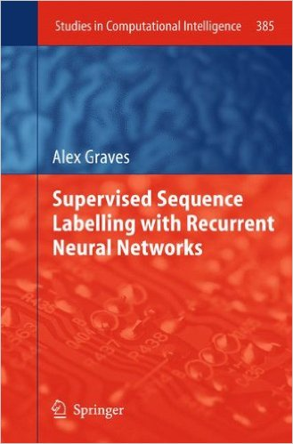
Reference
K. Greff, R. K. Srivastava, J. Koutník, B. R. Steunebrink, J. Schmidhuber, "LSTM: A Search Space Odyssey," in IEEE Transactions on Neural Networks and Learning Systems, 2016
Rafal Józefowicz, Wojciech Zaremba, Ilya Sutskever, “An Empirical Exploration of Recurrent Network Architectures,” in ICML, 2015
https://www.cs.toronto.edu/~graves/preprint.pdf
Notes:
Alex Graves (computer scientist)
Alex Graves is a research scientist at DeepMind, and the creator of Neural turing machines.^{[1]} He did a BSc in Theoretical Physics at Edinburgh and obtained a PhD in AI at IDSIA.^{[2]} He was also a postdoc under Geoff Hinton.^{[3]}
。希臘文學中的經典荷馬(Homer)史詩「奧德賽」(Odyssey)

Slide 16

Recurrent Neural Network
h and h’ are vectors with the same dimension
Given function f: $h^{′},y=f\left(h,x\right)$
y¹
y²
y³
h⁰
f
h¹
f
h²
f
h³
……
x¹
x²
x³
No matter how long the input/output sequence is, we only need one function f

Slide 17



Deep RNN
$$h^{′},y=f_{1}\left(h,x\right)$$
$$b^{′},c=f_{2}\left(b,y\right)$$
$$…$$
…
…
…
c¹
c²
c³
b⁰
f₂
b¹
f₂
b²
f₂
b³
……
y¹
y²
y³
h⁰
f₁
h¹
f₁
h²
f₁
h³
……
x¹
x²
x³

Slide 18



Bidirectional RNN
$$h^{′},a=f_{1}\left(h,x\right)$$
$$b^{′},c=f_{2}\left(b,x\right)$$
x¹
x²
x³
b⁰
f₂
b¹
f₂
b²
f₂
b³
c¹
c²
c³
y¹
y²
y³
$$y=f_{3}\left(a,c\right)$$
f₃
f₃
f₃
a¹
a²
a³
h⁰
f₁
h¹
f₁
h²
f₁
h³
x¹
x²
x³
Notes:
To determine yi, you have to consider a lot ……
There are more different types in the slides of HW3.

Slide 19
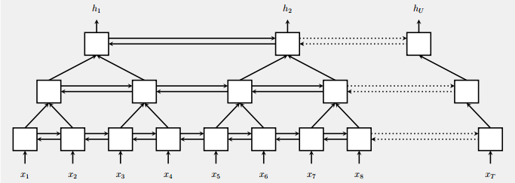
Pyramidal RNN
Reducing the number of time steps
W. Chan, N. Jaitly, Q. Le and O. Vinyals, “Listen, attend and spell: A neural network for large vocabulary conversational speech recognition,” ICASSP, 2016
Notes:
which reduces the number of time steps

Slide 20


Naïve RNN
Given function f: $h^{′},y=f\left(h,x\right)$
y
h'
W^{h}
h
W^{i}
x
$$+$$
$$=σ\left( \right)$$
h
f
h'
y
Wº
h'
$$=σ\left( \right)$$
x
softmax
Ignore bias here

Slide 21
LSTM
y^{t}
LSTM
c^{t}
y^{t}
c^{t-1}
Naive
h^{t}
h^{t}
h^{t-1}
h^{t-1}
x^{t}
x^{t}
c change slowly
c^{t} is c^{t-1} added by something
h change faster
h^{t} and h^{t-1} can be very different

Slide 22
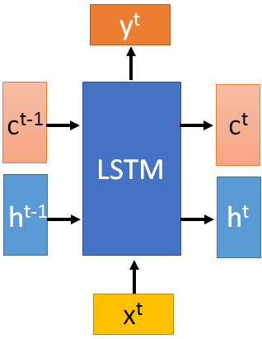




x^{t}
z
W
$$=tanh\left( \right)$$
h^{t-1}
c^{t-1}
x^{t}
z^{i}
W^{i}
$$=σ\left( \right)$$
h^{t-1}
x^{t}
z^{f}
W^{f}
$$=σ\left( \right)$$
h^{t-1}
z^{f}
z^{i}
z
zº
x^{t}
zº
Wº
$$=σ\left( \right)$$
h^{t-1}
x^{t}
h^{t-1}
Notes:
Identiy
C is vector

Slide 23

x^{t}
z
W
h^{t-1}
$$=tanh\left( \right)$$
c^{t-1}
c^{t-1}
diagonal
“peephole”
zº
z^{f}
z^{i}
obtained by the same way
z^{f}
z^{i}
z
zº
h^{t-1}
x^{t}
Notes:
Identiy
C is vector

Slide 24








y^{t}
c^{t-1}
c^{t}
$$⨀$$
$$＋$$
$$⨀$$
tanh
$$c^{t}=z^{f}⨀c^{t−1}$$
$$+z^{i}⨀z$$
$$⨀$$
$$h^{t}=z^{o}⨀tanh\left(c^{t}\right)$$
z^{f}
z^{i}
z
zº
$$y^{t}=σ\left(W^{′}h^{t}\right)$$
h^{t-1}
x^{t}
h^{t}
Notes:
Identiy
C is vector

Slide 25








LSTM
y^{t}
y^{t+1}
c^{t-1}
c^{t}
c^{t+1}
$$⨀$$
$$＋$$
$$⨀$$
$$⨀$$
$$＋$$
$$⨀$$
tanh
tanh
$$⨀$$
$$⨀$$
z^{f}
z^{i}
z
zº
z^{f}
z^{i}
z
zº
h^{t}
h^{t-1}
x^{t}
h^{t}
x^{t+1}
Notes:
https://arxiv.org/pdf/1412.3555.pdf
Identiy
C is vector

Slide 26
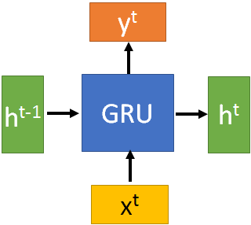
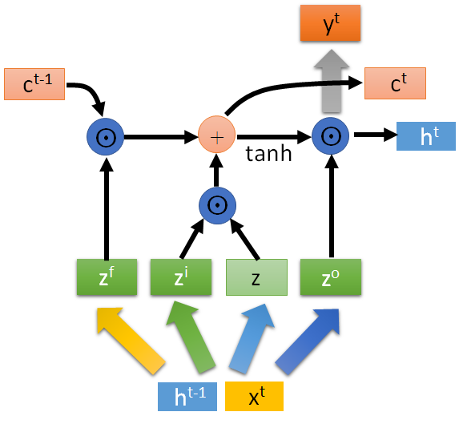





GRU
$$h^{t}=z⨀h^{t}+\left(1−z\right)⨀h^{′}$$
y^{t}
h^{t-1}
$$⨀$$
$$＋$$
h^{t}
$$⨀$$
1-
$$⨀$$
reset
update
r
z
h'
h^{t-1}
x^{t}
x^{t}
Notes:
It combines the forget and input gates into a single “update gate.” It also merges the cell state and hidden state, and makes some other changes.
The update gate in GRU is corresponding to the forget gate in LSTM.
In GRU, reset gate does not control the amount of the candidate hidden state independently, it shares some information of update gate and thus has access to important temporal information for phoneme segmentation\cite{chung2014empirical}.

Slide 27

Example Task
(Simplified) Speech Recognition: Frame classification on TIMIT
y¹
y²
y³
y¹
y²
y³
y⁴
……
y⁴
……
TSI
TSI
TSI
I
I
N
N
N
S
S
@
@
@
@
x¹
x²
x³
x⁴
……
x¹
x²
x³
x⁴
……
Utterance 1
Utterance 2

Slide 28
Target Delay
Only for unidirectional RNN
x
Delay 3 steps:
x
x
TSI
TSI
TSI
I
I
N
N
N
True labels:
TSI
TSI
TSI
I
I
N
N
N

Slide 29
LSTM > RNN > feedforward
Bi-direction > uni-direction

Slide 31
Forward direction
Reverse direction

Slide 32
Training LSTM is faster than RNN

Slide 33
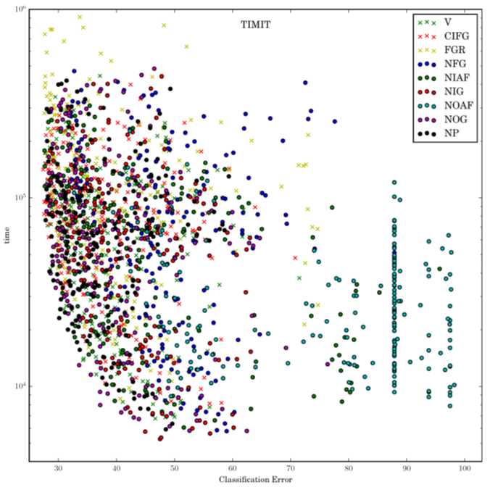
Notes:
1. No Input Gate (NIG) 2. No Forget Gate (NFG) 3. No Output Gate (NOG) 4. No Input Activation Function (NIAF) 5. No Output Activation Function (NOAF) 6. No Peepholes (NP) 7. Coupled Input and Forget Gate (CIFG) 8. Full Gate Recurrence (FGR)

Slide 34
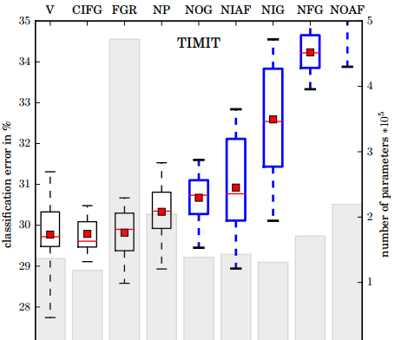
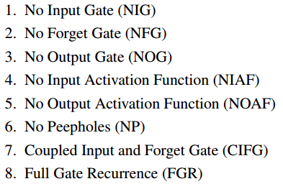
LSTM: A Search Space Odyssey
Standard LSTM works well
Simply LSTM: coupling input and forget gate, removing peephole
Forget gate is critical for performance
Output gate activation function is critical
Notes:
There are more analysis about the interation between the paramters.
Boxes show the range between the 25th and the 75th percentile of the data, while the whiskers indicate the whole range. The red dot represents the mean and the red line the median of the data. The boxes of variants that differ significantly from the vanilla LSTM are shown in blue with thick lines.

Slide 35
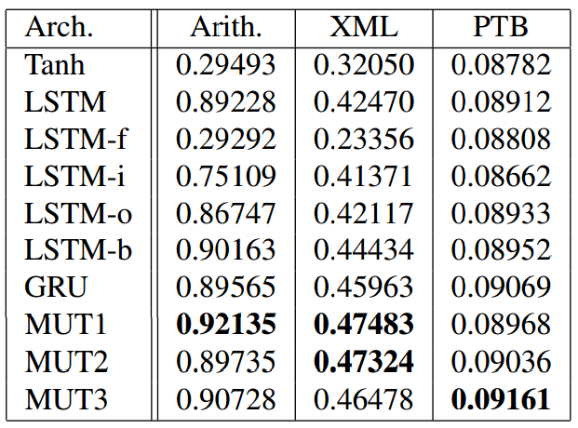
An Empirical Exploration of Recurrent Network Architectures
LSTM-f/i/o: removing forget/input/output gates
Importance: forget > input > output
LSTM-b: large bias
Large bias for forget gate is helpful
Notes:
算術

Slide 36
An Empirical Exploration of Recurrent Network Architectures

Slide 37
Stack RNN
Armand Joulin, Tomas Mikolov, Inferring Algorithmic Patterns with Stack-Augmented Recurrent Nets, arXiv Pre-Print, 2015
y^{t}
Push
Pop
Nothing
f
+
+
Information to store
……
Push, Pop, Nothing
0.7
0.2
0.1
…
…
…
X0.7
X0.2
X0.1
stack
x^{t}

Slide 38
Basic Structure: Convolutional / Pooing Layer
Simplify the neural network
(based on prior knowledge of the task)

Slide 39
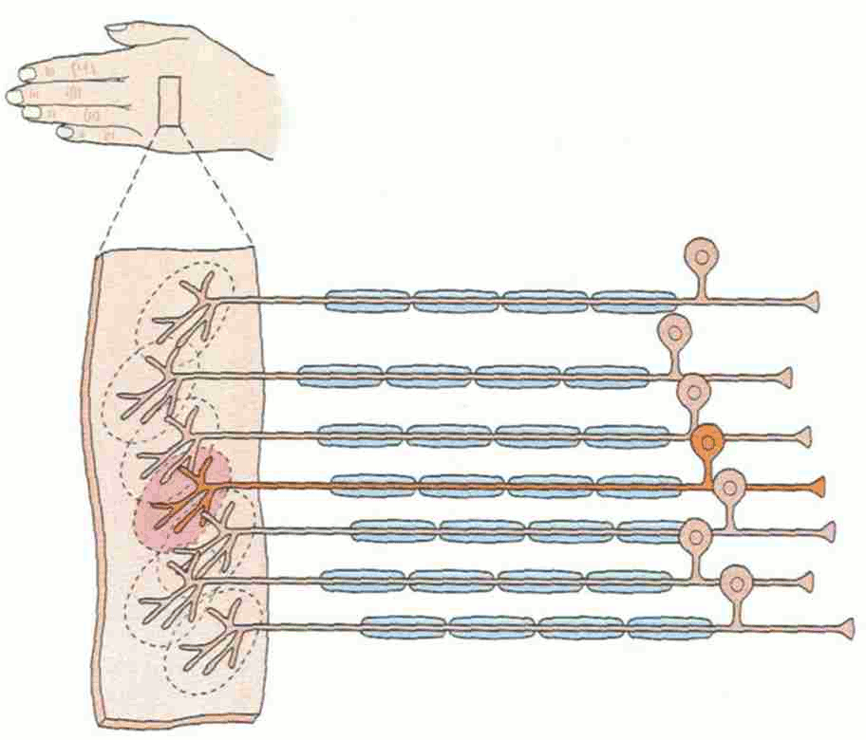
Convolutional Layer
Receptive Field
Sparse Connectivity
Each neural only connects to part of the output of the previous layer
Different neurons have different, but overlapping, receptive fields
……

Slide 40
Convolutional Layer
Sparse Connectivity
Each neural only connects to part of the output of the previous layer
Parameter Sharing
The neurons with different receptive fields can use the same set of parameters.
Less parameters then fully connected layer
……

Slide 41
Convolutional Layer
Considering neuron 1 and 3 as “filter 1” (kernel 1)
filter (kernel) size: size of the receptive field of a neuron
Stride = 2
Considering neuron 2 and 4 as “filter 2” (kernel 2)
Kernel size, no. of filter, stride are all designed by the developers.
……

Slide 42
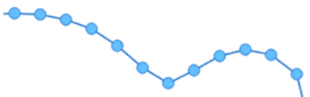





Example – 1D Signal + Single Channel
Classification, Predict the future …
Audio Signal,
Stock Value …
$$x_{1}$$
$$x_{2}$$
$$x_{3}$$
$$x_{4}$$
$$x_{5}$$

Slide 43







Example – 1D Signal + Multiple Channel
A document: each word is a vector
I
$$x_{1}$$
$$x_{2}$$
$$x_{3}$$
$$x_{4}$$
$$x_{5}$$
like
$$x_{6}$$
$$x_{7}$$
this
movie
very
much
Does this kind of receptive field make sense?
……

Slide 44
Example – 2D Signal + Single Channel
1:
1
2:
0
3:
0
4:
0
Size of Receptive field is 3x3, Stride is 1
…
7:
0
1 | 0 | 0 | 0 | 0 | 1
0 | 1 | 0 | 0 | 1 | 0
0 | 0 | 1 | 1 | 0 | 0
1 | 0 | 0 | 0 | 1 | 0
0 | 1 | 0 | 0 | 1 | 0
0 | 0 | 1 | 0 | 1 | 0
8:
1
9:
0
10:
0
…
13:
0
14:
0
6 x 6 black & white picture image
15:
1
Only show 1 filter here
16:
1
…

Slide 45
Example – 2D Signal + Multiple Channel
1:
1
1
0
2:
0
0
0
3:
0
1
0
4:
0
0
0
Size of Receptive field is 3x3x3, Stride is 1
…
7:
0
0
0
1 | 0 | 0 | 0 | 0 | 1
0 | 1 | 0 | 0 | 1 | 0
0 | 0 | 1 | 1 | 0 | 0
1 | 0 | 0 | 0 | 1 | 0
0 | 1 | 0 | 0 | 1 | 0
0 | 0 | 1 | 0 | 1 | 0
8:
1
1
0
1 | 0 | 0 | 0 | 0 | 1
0 | 1 | 0 | 0 | 1 | 0
0 | 0 | 1 | 1 | 0 | 0
1 | 0 | 0 | 0 | 1 | 0
0 | 1 | 0 | 0 | 1 | 0
0 | 0 | 1 | 0 | 1 | 0
1 | 0 | 0 | 0 | 0 | 1
0 | 1 | 0 | 0 | 1 | 0
0 | 0 | 1 | 1 | 0 | 0
1 | 0 | 0 | 0 | 1 | 0
0 | 1 | 0 | 0 | 1 | 0
0 | 0 | 1 | 0 | 1 | 0
9:
0
1
0
10:
0
0
0
…
13:
0
1
1
14:
0
1
1
15:
1
0
1
Only show 1 filter here
6 x 6 colorful image
16:
1
1
0
…

Slide 46
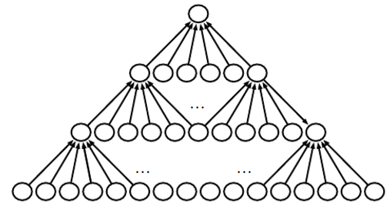
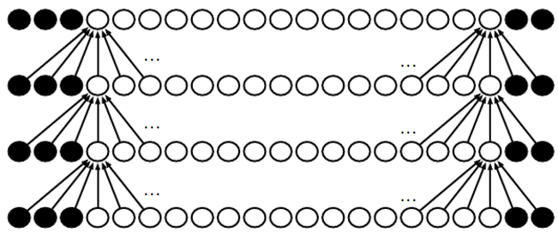
Without
Zero Padding
Zero
Padding
Notes:
If a task relies on preserving precise spatial
information, then using pooling on all features can increase the training error.
Some convolutional network architectures (Szegedy et al., 2014a) are designed to
use pooling on some channels but not on other channels, in order to get both
highly invariant features and features that will not underﬁt when the translation
invariance prior is incorrect.
Usually the optimal amount of zero padding (in
terms of test set classiﬁcation accuracy) lies somewhere between “valid” and “same”
convolution.

Slide 47
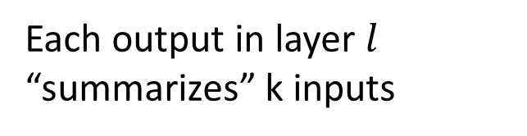
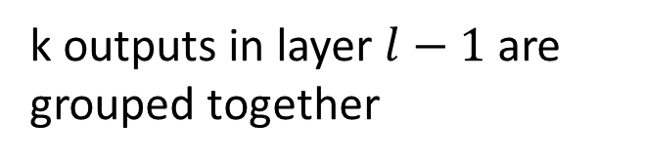
Pooling Layer
k outputs in layer $l−1$ are grouped together
Each output in layer $l$ “summarizes” k inputs
Average Pooling:
…
Max Pooling:
…
…
…
L2 Pooling:
Layer
Layer
nodes
nodes
Notes:
Mixing
Top K

Slide 48
Pooling Layer
Which outputs should be grouped together?
Convolutional
Layer
Pooling
Layer
Subsampling
Group the neurons corresponding to the same filter with nearby receptive fields
……

Slide 49




Pooling Layer
Which outputs should be grouped together?
Convolutional
Layer
Pooling
Layer
Maxout Network
How can you know whether the neurons detect the same pattern?
……
Group the neurons with the same receptive field

Slide 50
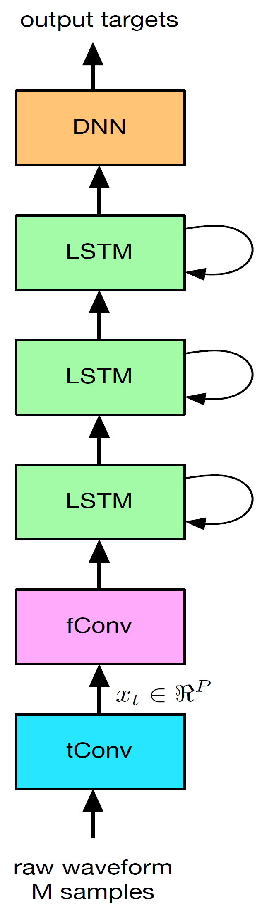
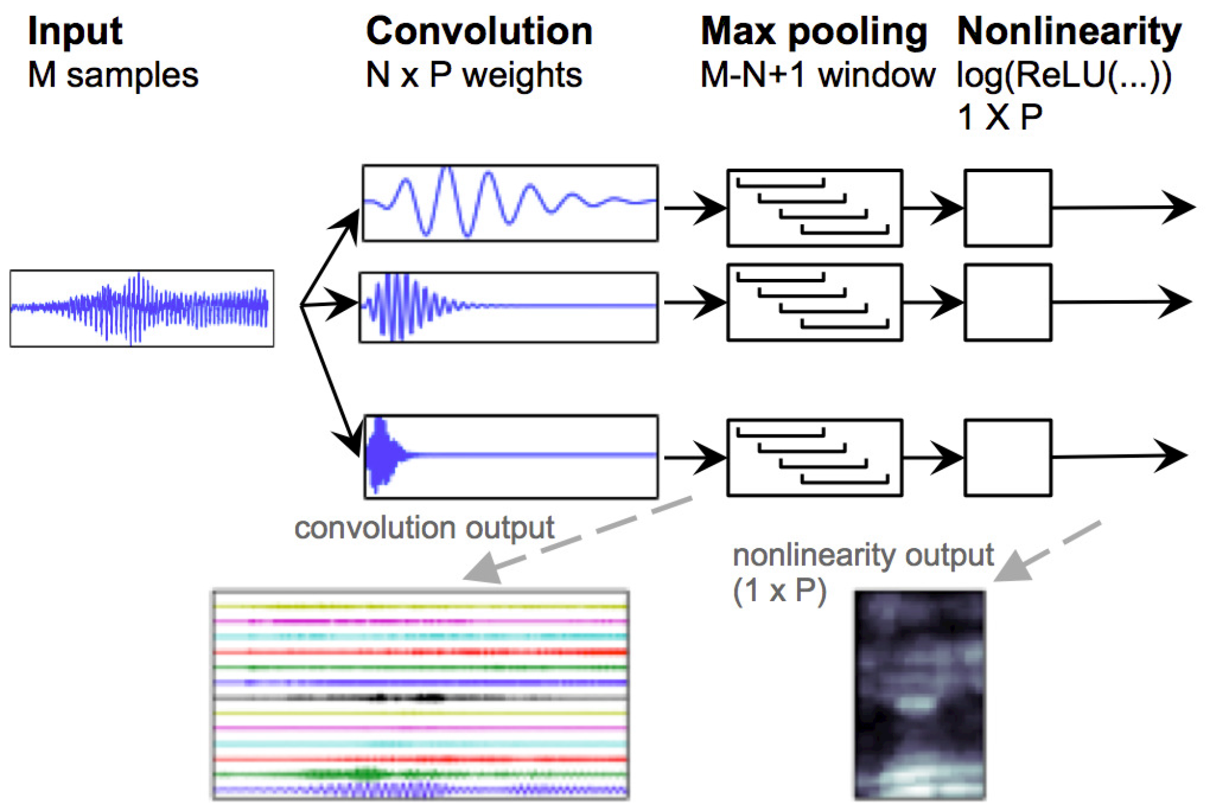

Combination of Different Basic Layers
Tara N. Sainath, Ron J. Weiss, Andrew Senior, Kevin W. Wilson, Oriol Vinyals, “Learning the Speech Front-end With Raw Waveform CLDNNs,” In INTERPSEECH 2015

Slide 51

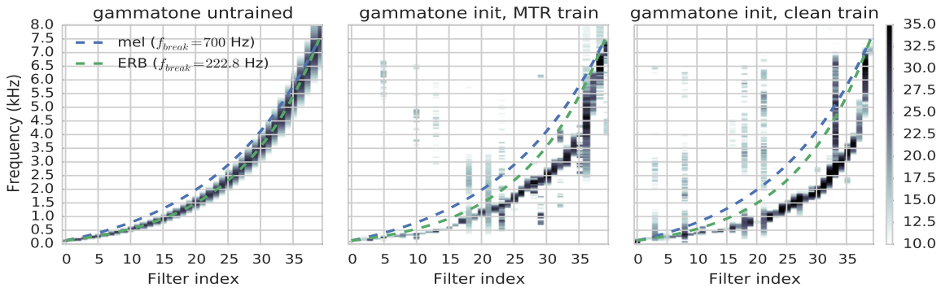
Combination of Different Basic Layers
Tara N. Sainath, Ron J. Weiss, Andrew Senior, Kevin W. Wilson, Oriol Vinyals, “Learning the Speech Front-endWith Raw Waveform CLDNNs,” In INTERPSEECH 2015

Slide 52
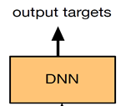

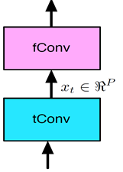
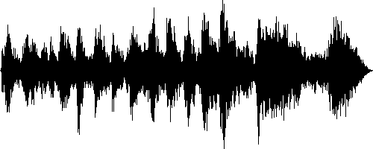
Combination of Different Basic Layers
Tara N. Sainath, Ron J. Weiss, Andrew Senior, Kevin W. Wilson, Oriol Vinyals, “Learning the Speech Front-endWith Raw Waveform CLDNNs,” In INTERPSEECH 2015
3 layers

Slide 53
Next Time
3/10: TAs will teach TensorFlow
TensorFlow for regression
TensorFlow for word vector
word vector: https://www.youtube.com/watch?v=X7PH3NuYW0Q
TensorFlow for CNN
If you want to learn Theano
http://speech.ee.ntu.edu.tw/~tlkagk/courses/MLDS_2015_2/Lecture/Theano%20DNN.ecm.mp4/index.html
http://speech.ee.ntu.edu.tw/~tlkagk/courses/MLDS_2015_2/Lecture/Theano%20RNN.ecm.mp4/index.html

